Slide 1
Support Vector Machines
© 2025 Virginia Polytechnic Institute and State University. All rights reserved.
Notes:
Welcome to our module on Support Vector Machines. Support vector machines, and other similar classifiers, are widely used classification techniques in machine learning. Their ability to accommodate linear or non-linear classification in high-dimensional data makes support vector machines a versatile classification tool. While the mathematical details of support vector machines can be somewhat complicated, the general concepts around how they work are relatively simple. This module will highlight the key components and uses, with a brief explanation of how they work.

Slide 2
At the end of this module, you should be able to:
Describe the maximal margin classifier
Describe the support vector classifier
Describe support vector machines (SVM)
Implement SVM with different hyper-parameter settings for classification in Python

Slide 3
Support Vector Machines

Slide 4
Introduction to Machine Learning Course Roadmap
What is the goal of the data analysis?
Predict an output |  |  |  |  |  | Reveal patterns or relationships |  | Make decisions using an autonomous agent
Supervised Learning (Output in the data set) |  |  |  |  |  | Unsupervised Learning (No output in the data set) |  | Reinforcement Learning* (Supervised & unsupervised)
Continuous or discrete output? |  |  |  |  |  | What is the subgoal? |  | Does a model exist?
Continuous |  |  | Discrete |  |  | Identify groups | Reduce dimensions | Model Based | Model Free
Simple linear regression Multiple linear regression Subset selection Ridge regression & LASSO PCR & PLS | Polynomial regression Step functions Splines Local regression General additive models | Decision tree Random forest Neural network Gradient boosting tree | Logistic regression Linear discriminant analysis Quadratic discriminant analysis | Decision tree Random forest Neural network Gradient boosting tree | Support vector machines | Hierarchical clustering K-means clustering | Principal components analysis | Given the model Learn the model | Policy Optimization Q-Learning
Support vector machines
*Advanced Topic: Bonus module if time
Notes:
In the previous modules, we discussed several supervised learning methods for a discrete or categorical response. Now we are going to look at another classifier, support vector machines

Slide 5
Supervised versus unsupervised again
Some tangible measurement(s)
“The Black Box”
INPUTS
MACHINE LEARNING MODEL
OUTPUT(S)
Supervised Learning
In the context of domain knowledge
“The Black Box”
INPUTS
MACHINE LEARNING MODEL
PATTERNS,
RELATIONSHIPS, STRUCTURE
Unsupervised Learning
does it make sense?
Notes:
Support Vector Machines (or SVMs) fall under the supervised learning context. Recall, this means we have an output or response in the form of a dependent variable that we are trying to predict.

Slide 6
Supervised learning method selection is based on the response type
Is my response quantitative or qualitative?
Age
Height
Income
Stock Price
Tensile Strength
Quantitative
Qualitative
Blood Type
Default on Debt (y/n)
Cancer Stage
Brand Purchased
Species
Typically use regression method
Typically use classification method
Discrete: Nominal or Ordinal
Continuous Measures
What about the predictors?
For most methods, predictors can be
either quantitative or qualitative.
Notes:
Support vector machines, and associated techniques, are typically used within the classification framework for categorical outcomes such as default/non-default or whether to route a call to one of three different departments. It is important to note that there are extensions of SVM that fall under regression, but those will not be covered in this module.

Slide 7
Two methods of estimation
Parametric
(Less Flexible, More Interpretable)
Non-parametric
(More Flexible, Less Interpretable)
Inference focused
Select a model which involves an assumption about the functional form of f. Train the model and estimate parameters.
Example:
f is linear in X: f(X) = β₀+β₁X₁ + β₂X₂ +…+ β_{p}X_{p}
Prediction focused
Does not make explicit assumptions about the functional form of f. Can fit wider range of possible shapes for f, but at that cost of needing a larger number of observations.
Example:
Tree-based methods
Notes:
SVMs can also be considered either parametric or non-parametric. Very simple support vector machines may be considered parametric because they are based on simple mathematical functions. However, the more complicated extensions are often considered non-parametric.

Slide 8
Support Vector Machines

Slide 9
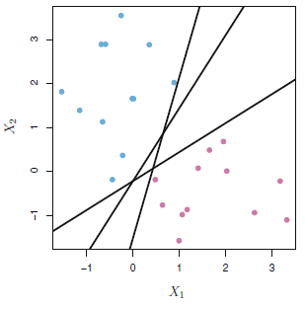
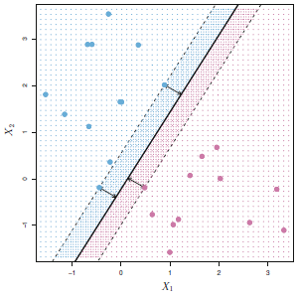
Which line will classify the points into blue and pink most accurately?
Maximal margin classifier attempts to find the separator that produces the largest distance from the closest point from the separator
Blue
Blue
Pink
Pink
Notes:
Let's say we have some training observations that fall into two classes and our data only takes on two dimensions.
Then our goal is simple, we want to draw a straight line through the graph here that best separates the observed classes (or in this case, we want to separate the pink from the blue points).
But as we can see in the plot on the left, we have three options drawn using black lines that perfectly separate the pink and blue. In fact, there's infinitely many lines we could draw that separate our points. So how do we choose? What line is "best"?
Well remember, we ultimately want our line to work for both the training AND test set. In order for us to have the most possible "confidence" that our line will work for the test set too, (click) we want the line that is the furthest away from training observations in terms of perpendicular distance. Or in other words, the line that has the largest margin around it before touching the training observations.
And in the plot on the right, you can see the margin is defined by the two blue points and single pink point that are all the same distance from the margin. The points that define the margin are called the support vectors.
The support vectors are the most important observations in the data because only these points define the margin. If they are moved just slightly, the margin and separating line would change.

Slide 10
Maximal margin classifier
Separating line
Highly effective classification tool
Idea is a lot like trying to construct the best separator
One approach is the maximal margin classifier, which attempts to find the separator that produces the largest distance from the closest point from the separator
The points on the margin are called support vectors
Support Vectors
Margin
Notes:
We're going to build up to SVM starting with a simpler technique called the maximal marginal classifier
This is another classification tool that is really effective when we have data that is easily separated into classes by a hyperplane.
We will call this the maximal marginal hyperplane as we introduced on the last slide, but what does that mean?

Slide 11
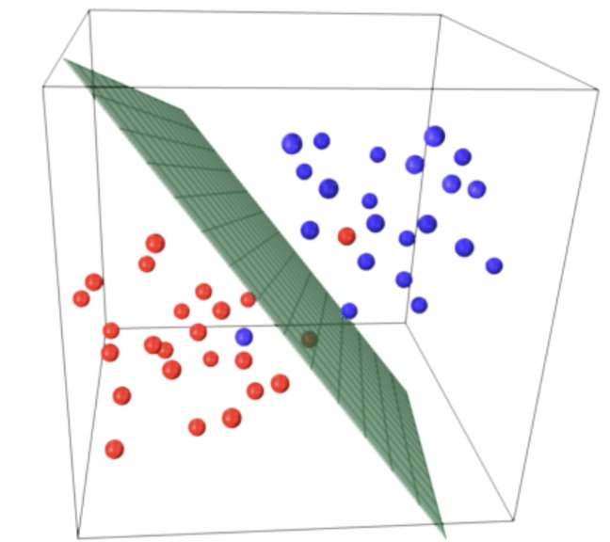
Maximal margin hyperplane extends past two dimensions
Rather than fitting a line, we fit a hyperplane of the corresponding dimension.
If we're working with k dimensions, we'll have a k-1 dimension hyperplane.
If we have 3 dimensions in our data (three X variables), the 2D hyperplane might look like the plot on the right.
https://umeshchandra.in/2024/04/19/understanding-support-vector-machines-svm/

Slide 12
Support Vector Machines

Slide 13
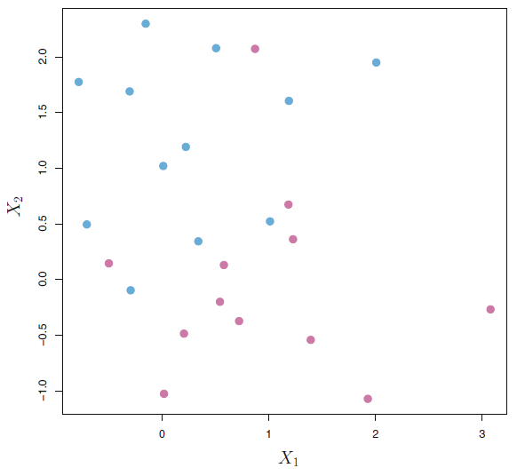
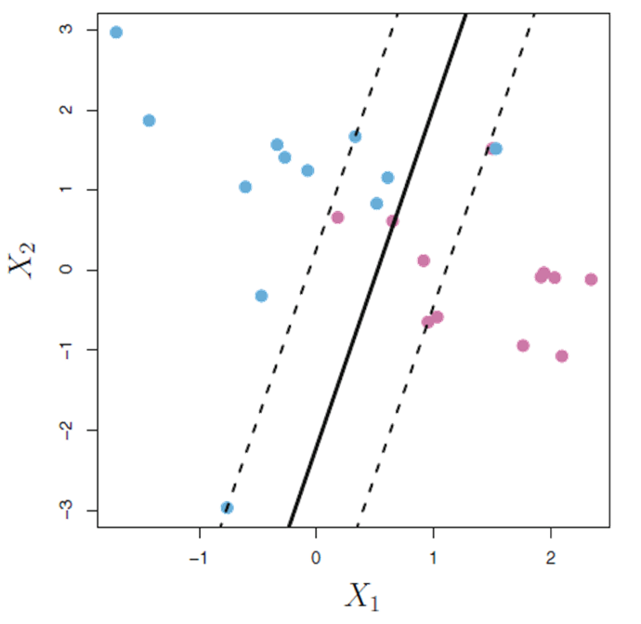
Use support vector classifiers if there is no valid perfect linear separator
Pink and Blue points do not have a single line of separation that perfectly classifies.
Support Vector Classifier
Allow for violations of the minimum distance principle & incorrect training classifications
Here, support vectors are the points that lie on or across the soft margin
Reduces variance & provides a classifier that can work where groups are not fully separable, but requires linear separator
Soft Margin
Notes:
What about this set of observations in the plot on the left? Where should we draw our separating line? Can we perfectly separate the colors?
There is no valid separator! We can't draw a line such that all the pink points are on one side and blue are on the other.
This means we can't use a maximal margin classifier – it doesn’t allow for misclassifications like this in the training set. We need a more general technique.
(click) rather than use a strict margin, what is we use a "soft margin" meaning it's ok if a couple points cross the margin and maybe even the separator.
This is what a Support Vector Classifier does. (click) It fits a hyperplane that best separates the two classes while making sure the sum of the errors does not exceed some threshold.
By errors here, we mean the degree to which our training points violate the margin or separator boundary.
Mention new df of support vectors
Note to speaker –
Maximal Margin does not allow for the misclassification
Point out blue on pink side and pink on blue side in first plot
Point out misclassified points
Why don’t we instead fit a non-linear separator?

Slide 14
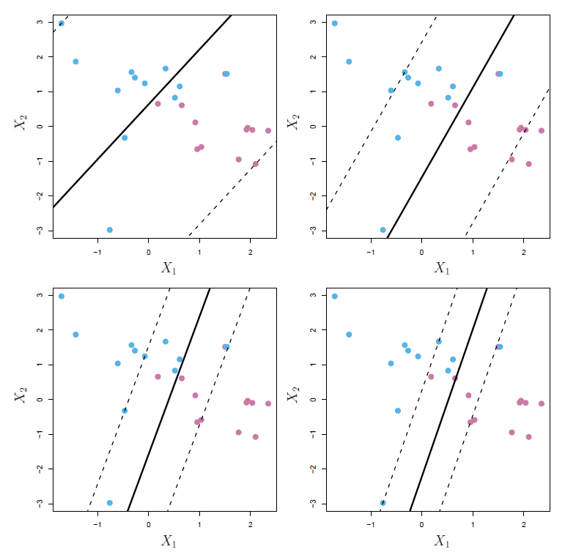
Adjust margins via tuning parameter C
We can adjust for how many violations of our boundary and the severity of the violations with a tuning parameter C
wide margin
high bias, low variance
Value of C decreases from left to right
narrow margin
low bias, high variance
Notes:
We can tune how much error we're willing to tolerate via a tuning parameter.
C is our (non-negative) tuning parameter that can be considered as the “budget” or “cost” for the amount that the margin can be violated by the n observations
If C=0, then there is no budget for violations to the margin. Ok if perfect separation
For C>0 no more than C observations can be on the wrong side of the hyperplane
As C increases, we become more tolerant of violations to the margin, so the margin will widen
As C decreases, we become less tolerant of violations to the margin, so the margin will narrow
C is typically chose using cross validation
C controls the bias-variance trade-off
When C is small, we seek narrow margins that are rarely violated; this amounts to a classifier that is highly fit to the data, which may have low bias but high variance
When C is large, we seek wide margins that allow more violations; this amounts to fitting the data less hard and obtaining a classifier that is potentially more biased but may have lower variance

Slide 15
Support Vector Machines

Slide 16
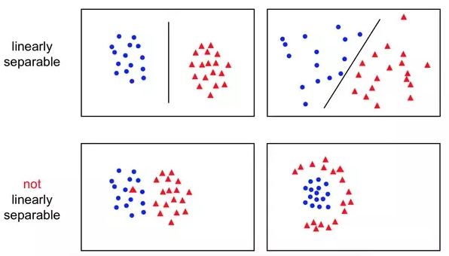
Some problems won’t work well with a linear separator
Notes:
Ok great, so we have techniques for when our data is linearly separable, and when it's close to being linearly separable, like we saw on the last slide.
What if it's not?
In the grid of plots here, notice the pattern in the lower right hand corner. It really doesn't make sense to draw any sort of straight line through these points. We'd be totally missing the very clear patter in our data.
The classifiers we've discussion so far aren't well suited for these types of patterns in our data.

Slide 17
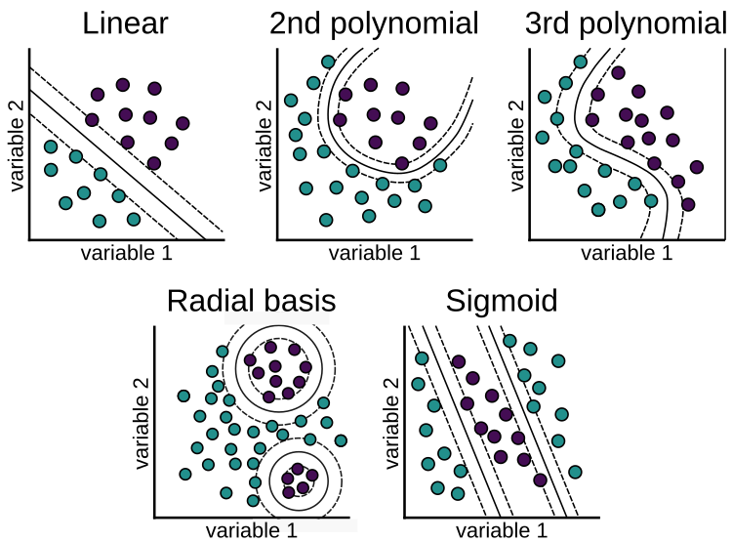
We can extend our model such that our separator can take any non-linear shape
Notes:
Instead, we can further extend what we've learned so far to Support Vector Machines or SVM
Rather than try to fit a hyperplane, SVM allows doe non-linear boundaries by using different types of kernels.
The plots on the slide show a few example of common kernels and the shapes the corresponding decision boundary may take on.
For example, the plot on the last slide that had the cluster of blue points surrounded by red points, we'd probably try a radial basis kernel to construct our separator.
SVM allow much greater flexibility by accommodating nearly any non-linear shape.
An advantage of support vector machines over other machine learning techniques is that they work well with high-dimensional data.
But be warned, as we've emphasized throughout this course, with greater flexibility come a greater chance of overfitting to our training data.

Slide 18
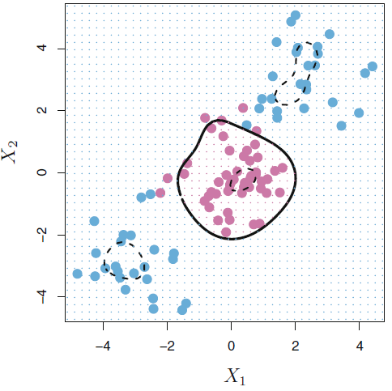
Support vector machines make this non-linear extension
Support Vector Machines (SVM) extend our model such that our separator can take any non-linear shape using kernels
Works well for binary classification
The SVM approach does not extend to greater than 2 classes
To classify to more than two classes we need to implement multiple SVMs
Notes:
An important note about SVMS is that they do not extend to more than 2 classes off the shelf
To classify more than two classes we need to implement multiple SVMs – the text book proposes two possible strategies to go about this. We won't dive into those here.
Are more support vectors “better”?
Computational Trade-offs: Training and prediction times are influenced by the number of support vectors. While a high number of support vectors can lead to better accuracy, it also increases computational costs.
The number of support vectors in an SVM classifier is intricately linked to the amount and complexity of the training data, as well as the performance of the classifier. While more support vectors can lead to better accuracy by capturing complex patterns, they also increase the risk of overfitting and computational costs.
(https://www.geeksforgeeks.org/optimizing-svm-classifiers-the-role-of-support-vectors-in-training-data-and-performance/)
The fact that only support vectors affect the classifier is in line with our previous assertion that C controls the bias-variance trade-off of the support vector classifier. When the tuning parameter C is large, then the margin is wide, many observations violate the margin, and so there are many support vectors. In this case, many observations are involved in determining the hyperplane. The top left panel in Figure 9.7 illustrates this setting: this classifier has low variance (since many observations are support vectors) but potentially high bias. In contrast, if C is small, then there will be fewer support vectors and hence the resulting classifier will have low bias but high variance. The bottom right panel in Figure 9.7 illustrates this setting, with only eight support vectors.

Slide 19
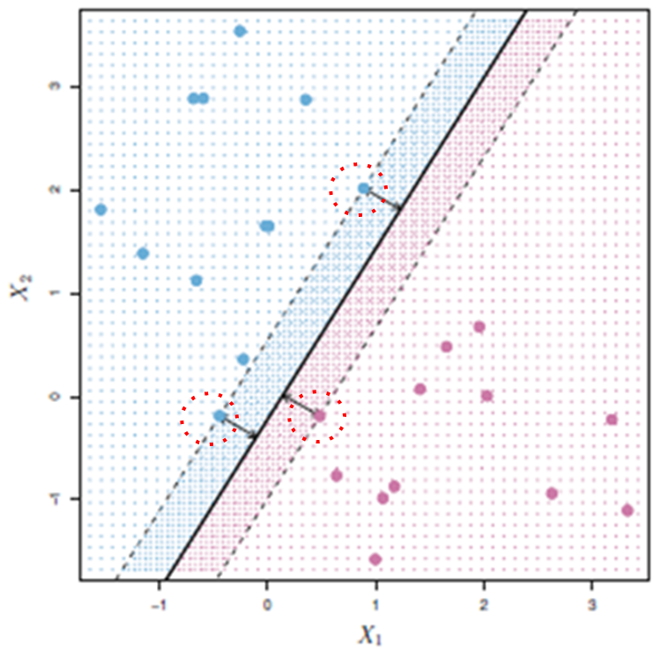
SVM compared to LDA, QDA & logistic regression
SVM is very similar to linear discriminant analysis (LDA), quadratic discriminant analysis (QDA), and logistic regression. The difference arises from the method of fitting the classifier
Unlike the other methods, SVMs rely solely on points close to the boundary
As a result, SVMs work better when the boundaries are clearly defined
Notes:
The fact that the support vector classifier’s decision rule is based only on a potentially small subset of the training observations (the support vectors) means that it is quite robust to the behavior of observations that are far away from the hyperplane. This property is distinct from some of the other classification methods that we have seen in preceding chapters, such as linear discriminant analysis. Recall that the LDA classification rule depends on the mean of all of the observations within each class, as well as the within-class covariance matrix computed using all of the observations. In contrast, logistic regression, unlike LDA, has very low sensitivity to observations far from the decision boundary. In fact we will see in Section 9.5 that the support vector classifier and logistic regression are closely related.

Slide 20
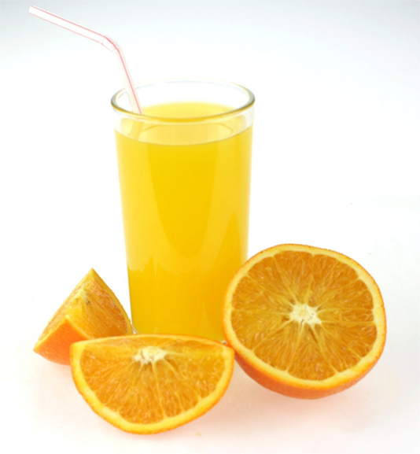
Exercise: Predicting orange juice purchases
Dataset: OJ (from the ISLP Python module or ISLR R package)
Objective: Use SVM with different hyper-parameter settings to classify orange juice purchases by brand (either Citrus Hill (CH) or Minute Maid (MM)).
Dependent variable: Brand (column in data is “Purchase” with 2 response categories CH=Citrus Hill, MM=Minute Maid)
Independent variables: Week of Purchase, Store ID #, Price of CH, Price of MM, Discount of CH, Discount of MM, Special on CH, Special on MM, Brand Loyalty to CH', Sale Price of MM, Sale Price of CH, Price Difference between brands, if purchase made at Store 7, % Discount on MM, % Discount on CH, Difference in List Price, Store location # (17 variables total)
For a description of all variables, see https://intro-stat-learning.github.io/ISLP/datasets/OJ.html
ThePhoto by PhotoAuthor is licensed under CCYYSA.

Slide 21
ML paradigm to evaluate model performance
Test Error: average error that results from using a machine learning method to predict the response on data that was not used in training the method
Models are built to do well on the data they’ve been fed. We want to ensure they also do well on data they haven’t encountered.
Whole Sample
Randomly
divide
Training set
Fit
Model
Prediction
Validation set
Tune
Test
Test Error
Test set
Notes:
Before we jump into the exercise, recall the ML paradigm to evaluate model performance with test error
A common way to evaluate its performance in this paradigm is through test error. The model is used to make predictions on the test set, which the model has not yet “seen”, and from these predictions we can get test error. Test error is the average error that results from using a machine learning method to predict the response on data that was not used in training the method. Remember, the model was only built using the training and validation sets, thus it was built to do well on that data. We want to ensure the model will also do well on new data, which is why a test set is used.
Recall for the purposes of this course, we will limit ourselves to training and test (exclude validation)

Slide 22
Code road map
1) Import Modules + Packages
2) Visualize Data
3) Build Training + Test Datasets
4) For each model:
Fit model with training data
Generate predicted labels
Evaluate performance
Notes:
Also recall our code rode map

Slide 23
We will start by fitting a classic linear SVM with cost/tuning parameter C=0.01, with Purchase as the response and the other variables as predictor. How many support points are there?
R Code
Fitting
the model
fit <- svm(Purchase ~ ., data = OJ[train, ], kernel = "linear", cost = 0.01)
summary(fit) # Summarize the fitted model
Summary
Python Code
Fitting
the model
svc = SVC(C=0.01, kernel='linear')
svc.fit(X_train, y_train)
svc.n_support_
Number of Support Vector

Slide 24
What are the training and test error rates?
R Code
Defining a function for calculating error rate
errs <- function(model) {
c(train = err(model, OJ[train, ]), test = err(model, OJ[test, ]))
}
errs(fit)
Error rate
Python Code
train_predictions = svc.predict(X_train)
test_predictions = svc.predict(X_test)
train_accuracy = accuracy_score(y_train, train_predictions)
test_accuracy = accuracy_score(y_test, test_predictions)
train_error_rate = 1 - train_accuracy
test_error_rate = 1 - test_accuracy
print(f"Training Error Rate: {train_error_rate:.5f}")
print(f"Testing Error Rate: {test_error_rate:.5f}")
Predictions
Accuracy
Error rate

Slide 25
Results for classic linear SVM with cost/tuning parameter C=0.01
In our dataset, we have 800 observations, 2 classes, and a total of 611 support vectors
217 belong to class CH
216 to class MM
Training error rate = 0.16750
Test error rate = 0.16667

Slide 26
Find an optimal value of C. Consider values in the range 0.01 to 10.
R Code
Python Code
svc = SVC(kernel='linear')
parameters = {'C':np.arange(0.01, 10, 2)}
clf = GridSearchCV(svc, parameters)
clf.fit(X_train, y_train)
GridSearchCV(cv=None, error_score='raise',
estimator=SVC(C=1.0, cache_size=200, class_weight=None, coef0=0.0,
decision_function_shape=None, degree=3, gamma='auto’, kernel='linear',
max_iter=-1, probability=False, random_state=1, shrinking=True, tol=0.001, verbose=False),
n_jobs=1,
param_grid={'C': np.array([ 0.01, 2.01, 4.01, 6.01, 8.01])},
pre_dispatch='2*n_jobs', refit=True, return_train_score=True,
scoring=None, verbose=0)
clf.best_params_
tuned <- tune(svm, Purchase ~ ., data = OJ[train, ], kernel = "linear", ranges = list(cost = seq(0.01, 10, by = 2)))
tuned$best.parameters
summary(tuned)
errs(tuned$best.model)
Use tune to
find optimal value
Summary
Error rate
Use GridSearchCV to find optimal value
Optimal cost

Slide 27
Compute the training and test error rates using this new value for C.
R Code
Error rate
errs(tuned$best.model)
Python Code
predictions
train_predictions = clf.predict(X_train)
test_predictions = clf.predict(X_test)
train_accuracy = accuracy_score(y_train, train_predictions)
test_accuracy = accuracy_score(y_test, test_predictions)
train_error_rate = 1 - train_accuracy
test_error_rate = 1 - test_accuracy
print(f"Training Error Rate: {train_error_rate:.3f}")
print(f"Testing Error Rate: {test_error_rate:.3f}")
Accuracy
Error rate

Slide 28
Results for classic linear SVM with optimal tuning parameter between 0.01 and 10
Optimal tuning parameter C = 8.01
Training error rate = 0.16125
Test error rate = 0.17037

Slide 29
Repeat parts (1) through (4) using a support vector machine with a radial kernel. Use the default rate for gamma.
R Code
Python Code
Fitting
the model
With radial
kernel
svc = SVC(C=0.01, kernel='rbf')
svc.fit(X_train, y_train)
SVC(C=0.01, cache_size=200, class_weight=None, coef0=0.0, decision_function_shape=None, degree=3, gamma='auto', kernel='rbf’, max_iter=-1, probability=False, random_state=1, shrinking=True,
tol=0.001, verbose=False)
svc.n_support_
train_predictions = svc.predict(X_train)
test_predictions = svc.predict(X_test)
train_accuracy = accuracy_score(y_train, train_predictions)
test_accuracy = accuracy_score(y_test, test_predictions)
train_error_rate = 1 - train_accuracy
test_error_rate = 1 - test_accuracy
Use tune to
find optimal value
tuned2 <- tune(svm, Purchase ~ ., data = OJ[train, ], kernel = "radial",
ranges = list(cost = seq(0.01, 10, by = 2)))
tuned2$best.parameters
errs(tuned2$best.model)
Number
of Support Vector
Optimal
Parameter
Error rate
predictions
accuracy
Error rate

Slide 30
Python code continued
Python Code
Print
result
print(f"Training Error Rate: {train_error_rate:.3f}")
print(f"Testing Error Rate: {test_error_rate:.3f}”
svc = SVC(kernel='rbf', random_state=1)
parameters = {'C':np.arange(0.01, 10, 2)}
clf = GridSearchCV(svc, parameters)
clf.fit(X_train, y_train)
GridSearchCV(cv=None, error_score='raise',
estimator=SVC(C=1.0, cache_size=200, class_weight=None, coef0=0.0,
decision_function_shape=None, degree=3, gamma='auto', kernel='rbf',
max_iter=-1, probability=False, random_state=1, shrinking=True,
tol=0.001, verbose=False),n_jobs=1,
param_grid={'C': np.array([ 0.01, 2.01, 4.01, 6.01, 8.01])},
pre_dispatch='2*n_jobs', refit=True, return_train_score=True,
scoring=None, verbose=0)
clf.best_params_
Use GridSearch to find optimal value
Optimal cost

Slide 31
Python code continued
Python Code
Prediction
train_predictions = clf.predict(X_train)
test_predictions = clf.predict(X_test)
train_accuracy = accuracy_score(y_train, train_predictions)
test_accuracy = accuracy_score(y_test, test_predictions)
train_error_rate = 1 - train_accuracy
test_error_rate = 1 - test_accuracy
print(f"Training Error Rate: {train_error_rate:.3f}")
print(f"Testing Error Rate: {test_error_rate:.3f}")
Accuracy
Error rate

Slide 32
Now set degree = 2
Python Code
R Code
Fitting
the model
With radial
kernel
svc = SVC(C=0.01, kernel='poly', degree=2)
svc.fit(X_train, y_train)
SVC(C=0.01, cache_size=200, class_weight=None, coef0=0.0, decision_function_shape=None, degree=2, gamma='auto', kernel='poly’, max_iter=-1, probability=False, random_state=1, shrinking=True,
tol=0.001, verbose=False)
svc.n_support_
train_predictions = svc.predict(X_train)
test_predictions = svc.predict(X_test)
train_accuracy = accuracy_score(y_train, train_predictions)
test_accuracy = accuracy_score(y_test, test_predictions)
train_error_rate = 1 - train_accuracy
test_error_rate = 1 - test_accuracy
Use tune to
find optimal value
tuned3 <- tune(svm, Purchase ~ ., data = OJ[train, ], kernel = "polynomial", ranges = list(cost = seq(0.01, 10, by = 2)), degree = 2)
tuned3$best.parameters
errs(tuned3$best.model)
Optimal
Parameter
Number
of Support Vector
Error rate
predictions
accuracy
Error rate

Slide 33
Python code continued
Python Code
Print
result
print(f"Training Error Rate: {train_error_rate:.3f}")
print(f"Testing Error Rate: {test_error_rate:.3f}")
svc = SVC(kernel='poly', degree=2, random_state=1)
parameters = {'C':np.arange(0.01, 10, 2)}
clf = GridSearchCV(svc, parameters)
clf.fit(X_train, y_train)
GridSearchCV(cv=None, error_score='raise',
estimator=SVC(C=1.0, cache_size=200, class_weight=None, coef0=0.0,
decision_function_shape=None, degree=2, gamma='auto', kernel='poly',
max_iter=-1, probability=False, random_state=42, shrinking=True,
tol=0.001, verbose=False),n_jobs=1,
param_grid={'C': np.array([ 0.01, 2.01, 4.01, 6.01, 8.01])},
pre_dispatch='2*n_jobs', refit=True, return_train_score=True,
scoring=None, verbose=0)
clf.best_params_
Use GridSearch to find optimal value
Optimal cost

Slide 34
Python code continued
Python Code
Prediction
train_predictions = clf.predict(X_train)
test_predictions = clf.predict(X_test)
train_accuracy = accuracy_score(y_train, train_predictions)
test_accuracy = accuracy_score(y_test, test_predictions)
train_error_rate = 1 - train_accuracy
test_error_rate = 1 - test_accuracy
print(f"Training Error Rate: {train_error_rate:.3f}")
print(f"Testing Error Rate: {test_error_rate:.3f}")
Accuracy
Error rate

Slide 35
Summary of results for orange juice purchases
R
 | Train Error Rate | Test Error Rate
Linear Kernel C = 0.01 | 0.17125 | 0.16296
Linear Kernel C = 2.01 | 0.16875 | 0.16667
Radial Kernel C = 0.01 | 0.38500 | 0.40370
Radial Kernel C = 2.01 | 0.14750 | 0.15556
Polynomial Degree 2 Kernel C = 0.01 | 0.38500 | 0.40370
Polynomial Degree 2 Kernel C = 8.01 | 0.14875 | 0.17037
Remember: Training and Test Sets are different between R and Python
Python
 | Train Error Rate | Test Error Rate
Linear Kernel C = 0.01 | 0.16750 | 0.16667
Linear Kernel C = 8.01 | 0.16125 | 0.17037
Radial Kernel C = 0.01 | 0.38000 | 0.41852
Radial Kernel C = 2.01 | 0.15125 | 0.19630
Polynomial Degree 2 Kernel C = 0.01 | 0.38000 | 0.41852
Polynomial Degree 2 Kernel C = 4.01 | 0.21500 | 0.27407

Slide 36
Support Vector Machines

Slide 37
Introduction to Machine Learning Course Roadmap
What is the goal of the data analysis?
Predict an output |  |  |  |  |  | Reveal patterns or relationships |  | Make decisions using an autonomous agent
Supervised Learning (Output in the data set) |  |  |  |  |  | Unsupervised Learning (No output in the data set) |  | Reinforcement Learning* (Supervised & unsupervised)
Continuous or discrete output? |  |  |  |  |  | What is the subgoal? |  | Does a model exist?
Continuous |  |  | Discrete |  |  | Identify groups | Reduce dimensions | Model Based | Model Free
Simple linear regression Multiple linear regression Subset selection Ridge regression & LASSO PCR & PLS | Polynomial regression Step functions Splines Local regression General additive models | Decision tree Random forest Neural network Gradient boosting tree | Logistic regression Linear discriminant analysis Quadratic discriminant analysis | Decision tree Random forest Neural network Gradient boosting tree | Support vector machines | Hierarchical clustering K-means clustering | Principal components analysis | Given the model Learn the model | Policy Optimization Q-Learning
Support vector machines
*Advanced Topic: Bonus module if time
Notes:
In the previous modules, we discussed several supervised learning methods for a discrete or categorical response. Now we are going to look at another classifier, support vector machines

Slide 38
Now you should be able to:
Describe the maximal margin classifier
Describe the support vector classifier
Describe support vector machines (SVM)
Implement SVM with different hyper-parameter settings for classification in Python

